Slide 1
Greedy Algorithms
Fang Xiaolin
School of Computer Science and Engineering
Southeast University

Slide 2
Outline
Greedy Algorithms
Activity Selection Problem
Huffman Code
Minimum Spanning Tree
Shortest Path

Slide 3
Greedy Algorithms
Greedy Algorithms
Select a best operation locally at each step
Can get optimal solution globally
Sufficient condition
Optimal Substructure
Greedy Selection

Slide 4
Greedy Algorithms
Optimal Substructure
Optimal solution of the entire problem contains the optimal solution of subproblems
Greedy Selection
Optimal solution of the entire problem can be obtained by the local optimal solution of each step

Slide 5
Activity Selection Problem
Activity
S={1,2,…,n} is the set of n activities which share one resource, the res can only be used by one activity at one time. Activity x_{i}=[s_{i，}f_{i}]
Activities not overlap
x_{i} and x_{j} not overlap，if s_{j}≥f_{i} 或 s_{i}≥f_{j}
s_{i}
f_{i}
s_{j}
f_{j}
s_{i}
s_{j}
f_{i}
f_{j}

Slide 6
Activity Selection Problem
Problem Definition
Input：S={1, 2, …, n}，x_{i}=[s_{i，}f_{i}]，1 ≤ i ≤ n
Output：maximum number of activities do not overlap with each other
Main idea of Greedy Algorithm
Select the activity with the smallest ending time f_{i}

Slide 7
Activity Selection Problem
Sort S by ending time，f₁≤f₂≤….≤f_{n}
Greedy-Activity-Selector(S, F)
n = length(S);
A = {1};
j = 1;
for i=2 to n do
if s_{i} ≥ f_{j} then
A = A∪{i}；
j=i；
return A
T(n) = θ(n)+θ(nlogn)
= θ(nlogn)

Slide 8
Activity Selection Problem
Greedy Selection
Let S={1, 2, …, n} be sorted by ending time, i.e. f₁≤f₂≤….≤f_{n} , the activity x₁ with smallest f₁ each time will be selected in some optimal solution.
Proof
Let A be an optimal solution, the activity in A with the smallest ending time be x_{k}=[s_{k，}f_{k}]
If x₁ is not selected in A, we have f₁ ≤ f_{k}
We can use x₁ to replace x_{k}
Choose x₁, the result is not worse
Notes:
1，假定首选元素不是贪心选择所要的元素，证明将首元素替换成贪心选择所需元素，依然得到最优解； 2，数学归纳法证明每一步均可通过贪心选择得到最优解

Slide 9
Huffman Code
Weighted Path Length
Each leaf node in a binary tree has a weight w_{i}，let the path length from the node to root be l_{i}，then w_{i *}l_{i}, define the total weighted path length of all leaf nodes as the weighted path length of the tree
2
7
4
5
2
4
5
7
4
2
5
7
WPL=2*(2+4+5+7)=36
WPL=2+2*4+3*(5+7)=46
WPL=7+2*5+3*(4+2)=35
Different tree may have different weighted path length
Huffman tree has the minimum weighted path length

Slide 10
Huffman Code
Given weights {w₁,w₂, …, w_{n}} of the leaf nodes, Construct Huffman tree
Initially, each leaf node be a binary tree, where weight of root is the weight of leaf
Loop until only one tree left
1. find two trees whose roots have the smallest weights, build a new tree where the root’s weight is the sum of the root’s weights of found two trees.
2. remove the found two trees

Slide 11
Huffman Code
F: {7} {5} {2} {4}
F: {7} {5} {6}
F: {7} {11}
F: {18}
7
5
2
4
7
5
6
7
11
18
2
4
5
6
7
11
(a) initial
2
4
5
6
(b) Combine {2}{4}
(b) Combine {2}{4}
2
4
(b) Combine {7}{11}

Slide 12
Huffman Code
Huffman code for data compression
Compute the probability of each char

Slide 13
Huffman Code
Huffman code for data compression
Given 1000-char text file which consists of a, b, c, d, e
Fixed length code uses 3 bits for each char
File needs 3*1000=3000 bits
char | Fixed length code
a | 000
b | 001
c | 100
d | 101
e | 110

Slide 14
Huffman Code
Huffman code for data compression
Given 1000-char text file which consists of a, b, c, d, e
Probability for each char be 0.12, 0.40, 0.15, 0.08, 0.25, then file can be represented with 2150 bits
Average code length
B(T) = 0.12*4 + 0.08*4 + 0.15*3 + 0.25*2 + 0.40*1
= 2.15
1.0
0
1
char | probs | Huffman code
a | 0.12 | 1111
b | 0.40 | 0
c | 0.15 | 110
d | 0.08 | 1110
e | 0.25 | 10
0.40(b)
0.6
0
1
0.25(e)
0.35
0
1
0.15(c)
0.2
0
1
0.08(d)
0.12(a)

Slide 15
Huffman Code
T
T’
x
a
y
b
Greedy selection
Let x and y be the two chars with the smallest probabilities, then x and y will have the longest code length in some optimal solution
Proof
Let a and b be the two chars longest lengths in an optimal solution A whose longest lengths
Then f(a)≥f(x), f(b)≥f(y), and L(a)≥L(x), L(b)≥L(y), exchange a and x, b and y, we have
B(T’) = B(T) -f(x)L(x)-f(y)L(y)-f(a)L(a)-f(b)L(b)
+f(x)L(a)+f(y)L(b)+f(a)L(x)+f(b)L(y)
=B(T)+(fx-fa)(La-Lx)+(fy-fb)(Lb-Ly) ≤ B(T)
a
b
x
y
Choose x and y, the result is not worse
Notes:
1，假定首选元素不是贪心选择所要的元素，证明将首元素替换成贪心选择所需元素，依然得到最优解； 2，数学归纳法证明每一步均可通过贪心选择得到最优解

Slide 16
Disjoint-set operations
Operations for disjoint sets
Union
Check two elements if they are in the same set

Slide 17
Disjoint-set operations
Operations for disjoint sets
Union(Root1,Root2): union Root2 and Root1
Find(x): find x belongs to which set

Slide 18
Disjoint-set operations
Use tree to represent a set
Initially, each element is a set (tree)
0
1
2
3
4
5
6
7
8
9
全集合S初始化时形成的森林
负数表示没有父结点
-1表示树中有1个结点
-2表示有2个结点，
以此类推
index
0
1
2
3
4
5
6
7
8
9
parent
-1
-1
-1
-1
-1
-1
-1
-1
-1
-1

Slide 19
Disjoint-set operations
Use tree to represent a set
3 sets: {0,6,7,8}, {1,4,9}, {2,3,5}
0
1
2
6
7
8
4
9
3
5
index
0
1
2
3
4
5
6
7
8
9
parent
-4
-3
-3
2
1
2
0
0
0
1

Slide 20
Disjoint-set operations
0
Use tree to represent a set
Union: s₁={0,6,7,8} ∪ s₂={1,4,9}
s₂ as the root of s₁，or vice versa
6
7
8
1
4
9
0
∪
1
Case 1
6
7
8
4
9
1
Union the two sets
index
0
1
2
3
4
5
6
7
8
9
0
4
9
parent
-7
0
-3
2
0
2
0
0
0
0
6
7
8
Case 2

Slide 21
Disjoint-set operations
0
Use tree to represent a set
Union: s₁={0,6,7,8} ∪ s₂={1,4,9}
s₂ as the root of s₁，or vice versa
Which way is better?
Look the find operation
The cost of Find operation is the path lenth to the root
6
7
8
1
4
9
Case 1
1
0
4
9
Case 1 is better for find operation
Union method:
The root of the tree with more elements as the final root
6
7
8
Case 2

Slide 22
Disjoint-set operations
Use tree to represent a set
Union: s₁={0,2,6,7,8} ∪ s₂={1,4,9}
The root of the tree with larger height as the final root
0
∪
1
0
6
7
8
4
9
6
7
8
1
2
2
4
9

Slide 23
Disjoint-set operations
Use tree to represent a set
Path compression after a find operation
0
1
0
2
1
2
3
3

Slide 24
Minimum Spanning Tree
Spanning Tree
设Given a edge-weighted undirected graph G=(V, E), a spanning tree of G is a tree T=(V, E’), E’⊆E。Weight of tree W(T)=∑_{(u,v)∈T}W(u,v)
Minimum Spanning Tree
The spanning tree with the minimum weight

Slide 25
Minimum Spanning Tree
Kruskal Algorithm
Initially, each vertex is a set
Find the edge with minimum weight (v_{i},v_{j})
If v_{i},v_{j} belong to different set, union(R(v_{i}),R(v_{j}) )
Else, drop this edge
Repeat until all the vertices are in one set

Slide 26
Minimum Spanning Tree
Kruskal Algorithm
28
0
1
0
1
0
1
0
1
10
14
16
10
10
5
6
2
5
6
2
5
6
2
5
6
2
24
18
12
25
12
4
3
4
3
4
3
4
3
22
0
1
0
1
0
1
0
1
10
14
10
14
16
10
14
16
10
14
16
5
6
2
5
6
2
5
6
2
5
6
2
12
12
12
25
12
4
3
4
3
4
22
3
4
22
3

Slide 27
Minimum Spanning Tree
Kruskal Algorithm
Check two vertices of an edge belonging to different sets
28
0
1
2
3
4
5
6
0
1
10
14
16
10 (0,5)
initially
12 (2,3)
5
6
2
14 (1,6)
24
18
25
12
16 (1,2)
4
22
3
18 (3,6)
22 (3,4)
24 (4,6)
25 (4,5)

Slide 28
Minimum Spanning Tree
Kruskal Algorithm
Check two vertices of an edge belonging to different sets
28
0
1
2
3
4
6
0
1
10
14
16
10 (0,5)
12 (2,3)
5
5
6
2
14 (1,6)
24
18
Check (0,5)
25
12
16 (1,2)
4
22
3
18 (3,6)
22 (3,4)
24 (4,6)
25 (4,5)

Slide 29
Minimum Spanning Tree
Kruskal Algorithm
Check two vertices of an edge belonging to different sets
28
0
1
2
4
6
0
1
10
14
16
10 (0,5)
12 (2,3)
5
3
5
6
2
14 (1,6)
24
18
Check (2,3)
25
12
16 (1,2)
4
22
3
18 (3,6)
22 (3,4)
24 (4,6)
25 (4,5)

Slide 30
Minimum Spanning Tree
Kruskal Algorithm
Check two vertices of an edge belonging to different sets
28
0
1
2
4
0
1
10
14
16
10 (0,5)
12 (2,3)
5
6
3
5
6
2
14 (1,6)
24
18
Check (1,6)
25
12
16 (1,2)
4
22
3
18 (3,6)
22 (3,4)
24 (4,6)
25 (4,5)

Slide 31
Minimum Spanning Tree
Kruskal Algorithm
Check two vertices of an edge belonging to different sets
28
0
1
4
0
1
10
14
16
10 (0,5)
12 (2,3)
5
6
2
5
6
2
14 (1,6)
24
18
25
12
16 (1,2)
4
3
3
22
18 (3,6)
22 (3,4)
Check (1,2)
24 (4,6)
25 (4,5)

Slide 32
Minimum Spanning Tree
Kruskal Algorithm
Check two vertices of an edge belonging to different sets
28
0
1
4
0
1
10
14
16
10 (0,5)
12 (2,3)
5
6
2
5
6
2
14 (1,6)
24
18
25
12
16 (1,2)
4
3
3
22
18 (3,6)
22 (3,4)
Check (3,6)
24 (4,6)
25 (4,5)

Slide 33
Minimum Spanning Tree
Kruskal Algorithm
Check two vertices of an edge belonging to different sets
28
0
1
0
1
10
14
16
10 (0,5)
12 (2,3)
5
6
2
4
5
6
2
14 (1,6)
24
18
25
12
16 (1,2)
4
3
3
22
18 (3,6)
22 (3,4)
Check (3,4)
24 (4,6)
25 (4,5)

Slide 34
Minimum Spanning Tree
Kruskal Algorithm
Check two vertices of an edge belonging to different sets
28
0
1
0
1
10
14
16
10 (0,5)
12 (2,3)
5
6
2
4
5
6
2
14 (1,6)
24
18
25
12
16 (1,2)
4
3
3
22
18 (3,6)
22 (3,4)
Check (4,6)
24 (4,6)
25 (4,5)

Slide 35
Minimum Spanning Tree
Kruskal Algorithm
Check two vertices of an edge belonging to different sets
28
1
0
1
10
14
16
10 (0,5)
12 (2,3)
0
6
2
4
5
6
2
14 (1,6)
24
18
25
12
16 (1,2)
4
3
5
3
22
18 (3,6)
22 (3,4)
Check (4,5)
All the vertices are in one set at this time
24 (4,6)
25 (4,5)

Slide 36
T₁
T₂
u
v
A
B
x
y
Greedy Selection
Let (u,v) is the edge with smallest weights and u and v belong to different sets, then there exists minimum spanning including (u,v)。
Proof:
Let T₁and T₂ be two subtrees get by Kruskal. The set be A and B respectively. Assume there is no minimum spanning tree including (u,v). Let mininum spanning tree connect A and B through (x,y). W(u,v)≤W(x,y)，W(T’)=W(T₁)+W(T₂)+W(u,v)≤ W(T₁)+W(T₂)+W(x,y)=W(T)，contradicts
T
Choose (u,v) is not worse

Slide 37
Shortest Path
Dijkstra Algorithm
Given an edge-weighted graph G=(V,E), weights ≥ 0, a source vertex v₀ and a destination vertex t,
find the shortest path from v₀ to t.

Slide 38
Shortest Path
Dijkstra Algorithm
First, set S={v₀}，dist[v₀]=0, dist[i]=Edge[v₀][i]
Find u∈S,v∉S, and dist[u]+Edge[u][v] is minimum, add v to S, and let dist[v]=dist[u]+Edge[u][v]
Repeat until all vertices are all in set S

Slide 39
Shortest Path
Dijkstra Algorithm
0
100
d=0
d=0
10
0
0
10
1
30
4
1
50
d=10
10
60
2
20
3
原图
0
d=0
0
d=0
0
d=0
10
10
10
1
30
1
30
1
30
4
d=10
d=10
d=10
d=60
10
3
2
20
3
2
20
3
d=30
d=50
d=30
d=50
d=30

Slide 40
Shortest Path
Dijkstra Algorithm
0
100
d[0]=0
p[0]=-1
d[0]=0
p[0]=-1
10
0
0
10
1
30
4
1
50
d[1]=10
p[1]=0
10
60
2
20
3
原图
0
d[0]=0
p[0]=-1
0
d[0]=0
p[0]=-1
0
d[0]=0
p[0]=-1
10
10
10
1
30
1
30
1
30
4
d[1]=10
p[1]=0
d[1]=10
p[1]=0
d[1]=10
p[1]=0
d[4]=60
p[4]=2
10
3
2
20
3
2
20
3
d[3]=30
p[3]=0
d[2]=50
p[2]=3
d[3]=30
p[3]=0
d[2]=50
p[2]=3
d[3]=30
p[3]=0

Slide 41
Shortest Path
Dijkstra Algorithm
0
0
d[0]=0
p[0]=-1
10
100
10
1
30
4
1
30
4
d[1]=10
p[1]=0
d[4]=60
p[4]=2
50
10
60
10
2
20
3
2
20
3
d[2]=50
p[2]=3
d[3]=30
p[3]=0
原图
获取最短路径方法，以顶点4为例：
p[4]=3
p[3]=2
p[2]=0
反向读得0到4的最短路径为 (0,3,2,4)

Slide 42
Shortest Path
Greedy Selection
S is the set in which vertices have known the shortest distance, Other vertices in B
dis[u]+E(u,v) is minimum, then dis[u]+E(u,v) is the shortest length from s to v.
s
…
u
v
x
y
S
B
Choose (u,v) is not worse

Slide 43
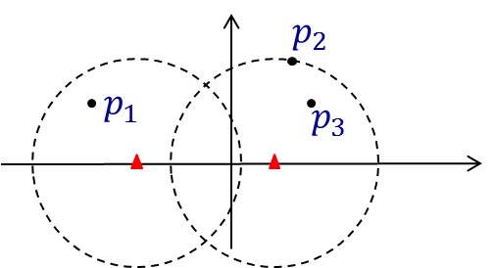
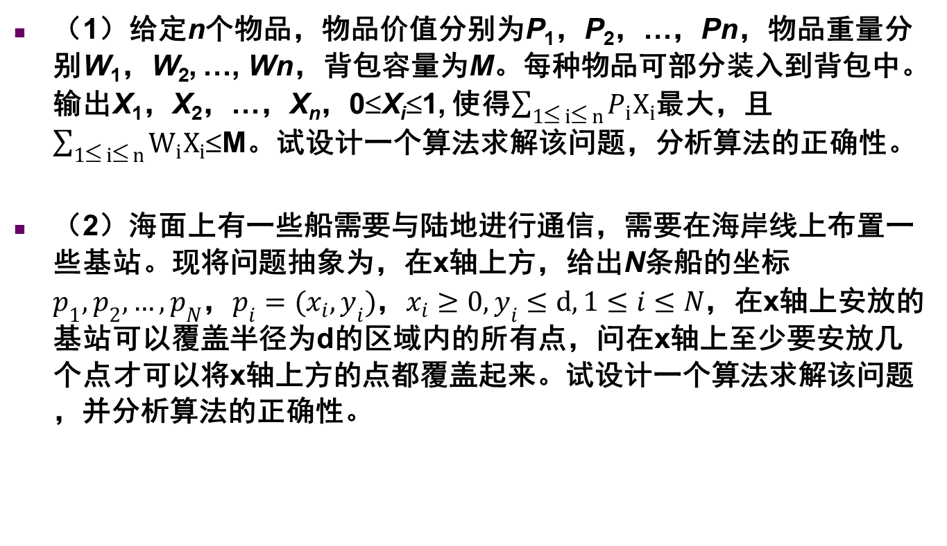
（1）给定n个物品，物品价值分别为P₁，P₂，…，Pn，物品重量分别W₁，W₂, …, Wn，背包容量为M。每种物品可部分装入到背包中。输出X₁，X₂，…，X_{n}，0≤X_{i}≤1, 使得$\sum_{1≤ i≤ n}{P_{i}X_{i}}$最大，且 $\sum_{1≤ i≤ n}{W_{i}X_{i}}$≤M。试设计一个算法求解该问题，分析算法的正确性。
（2）海面上有一些船需要与陆地进行通信，需要在海岸线上布置一些基站。现将问题抽象为，在x轴上方，给出N条船的坐标$p_{1},p_{2},…,p_{N}$，$p_{i}=(x_{i},y_{i})$，$x_{i}≥0, y_{i}≤d,1≤i≤N$，在x轴上安放的基站可以覆盖半径为d的区域内的所有点，问在x轴上至少要安放几个点才可以将x轴上方的点都覆盖起来。试设计一个算法求解该问题，并分析算法的正确性。

